Slide 1

AOA PROJECT
PRESENTATION
OPTIMIZATION ALGORITHM
ADARSH MADIVALA
VAISHNAVI MAGADUM
BHAVYA PANDYA
SAKSHI PARADKAR
KRISHA PATEL

Slide 2


Types of Optimization Algorithms:
1.Classical (Deterministic): Usually efficient, good for convex problems.
Gradient Descent (GD).
2. Metaheuristic (Stochastic): Good for complex, non-convex, NP-hard problems
Genetic Algorithm (GA), Simulated Annealing (SA), Particle Swarm Optimization (PSO).
An optimization algorithm is a method or procedure used to find the best possible solution (maximum or minimum) to a problem from a set of feasible solutions, under given constraints.
What is an Optimization Algorithm?

Slide 3

Iterative optimization algorithm that updates parameters in the direction of the negative gradient of the objective function until convergence.
Instead of strictly following the gradient, Simulated Annealing (SA) explores the parameter space by accepting not only better solutions but sometimes worse ones, depending on a "temperature" that cools over time. This helps escape local minima.
Gradient Descent (GD)
Simulated Annealing (SA)
Time Complexity = O(k⋅n⋅d)
k = number of iterations
n = number of samples
d = number of features
Time Complexity = O ( k ⋅ f )
k = number of iterations/temperature steps
f = cost of evaluating the objective function

Slide 4
Genetic Algorithm (GA)
It is an optimization technique inspired by natural selection and genetics. It evolves a population of candidate solutions using selection, crossover, and mutation to gradually improve fitness.
Particle Swarm Optimization
(PSO)
Best
debater's argument
goes here
Population-based optimization algorithm inspired by the social behavior of birds flocking or fish schooling, where particles (solutions) move through the search space to find the best solution.
Time Complexity = O(k⋅(P⋅d+P⋅f))
k = number of iterations ,
P = swarm size
d = number of dimensions ,
f = cost of evaluating fitness per particle
Time Complexity = O(G⋅(P⋅f + P logP))
G = number of generations
P = population size
f = cost of evaluating fitness per individual

Slide 5
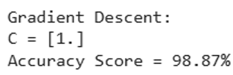


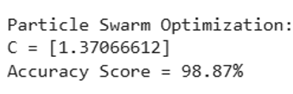
Apply Optimization to Logistic Regression using Student Performance Dataset
COMPARE
Particle Swarm Optimization
Gradient Descent
Simulated Annealing
Genetic Algorithm
VS
VS.
VS.
Gradient Descent is highly efficient for convex problems like student performance prediction, converging quickly with time complexity O(n·d·k).
Metaheuristic algorithms (SA, GA, PSO) are slower and computationally expensive, as they explore large solution spaces iteratively. For convex, differentiable problems, GD is faster, scalable, and more practical.

Slide 6

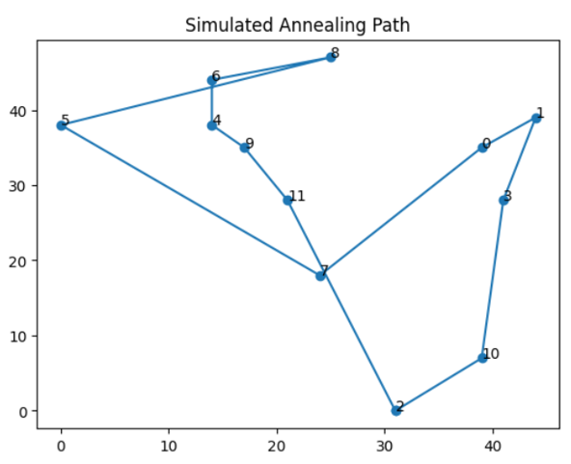
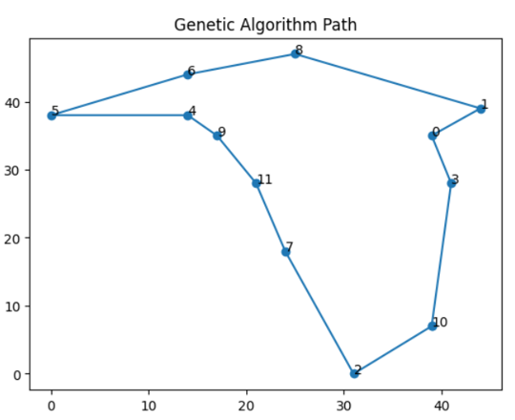
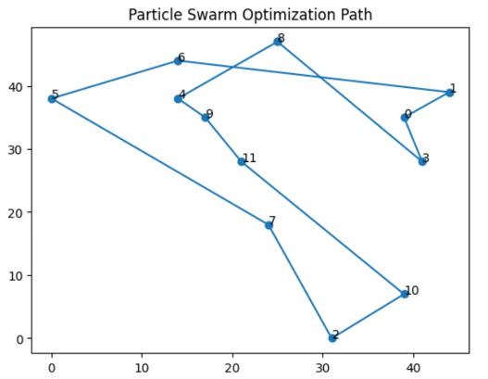



COMPARE
Traveling Salesman Problem
Simulated Annealing (SA) - is preferred for fast, near-optimal solutions.
Genetic Algorithm (GA) - is ideal when high accuracy and cost minimization are critical, despite longer computation.
Particle Swarm Optimization (PSO) balances speed and solution quality.

Slide 7

Thank you!
Analysis Of Algorithms

